Slide 1
Design and Analysis of Algorithms Lab
Dr. Sujata Joshi

Slide 2
Part A
7.
“Sunshine” a job search portal is looking for engineering graduates, they need to sort the candidate’s resume based on their ranking(Average Percentage). Ranking should be generated randomly. Design and develop a program in C to sort the resumes by using heap sort algorithm. Determine the time required to sort the elements. Repeat the experiment for different values of n and plot a graph of the time taken versus n.(n=no of elements).

Slide 3
Heap and Heap sort
DEFINITION A heap can be defined as a binary tree with keys assigned to its nodes, one key per node, provided the following two conditions are met:
1. The shape property—the binary tree is essentially complete (or simply complete), i.e., all its levels are full except possibly the last level, where only some rightmost leaves may be missing.
2. The parental dominance or heap property—the key in each node is greater than or equal to the keys in its children.

Slide 4
Heap sort is a two-stage algorithm that works as follows.
Stage 1 (heap construction): Construct a heap for a given array.
Stage 2 (maximum deletions): Apply the root-deletion operation n − 1 times to the remaining heap. As a result, the array elements are eliminated in decreasing order. But since under the array implementation of heaps an element being deleted is placed last, the resulting array will be exactly the original array sorted in increasing order.

Slide 5
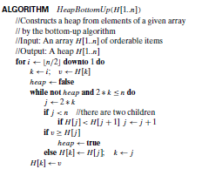

Slide 6
Maximum Key Deletion from a heap
Step 1 Exchange the root’s key with the last key K of the heap.
Step 2 Decrease the heap’s size by 1.
Step 3 “Heapify” the smaller tree by sifting K down the tree exactly in the same way we did it in the bottom-up heap construction algorithm. That is, verify the parental dominance for K: if it holds, we are done; if not, swap K with the larger of its children and repeat this operation until the parental dominance condition holds for K in its new position.

Slide 7
Algorithm heapsort(a,n)
last=n
for w←1 ..n do
exchange a[1] and a[last]
last - -
heapbottumup(a, last)

Slide 8
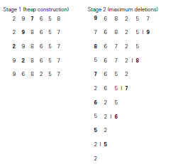
Sorting the array 2, 9, 7, 6, 5, 8 by heapsort.

Slide 9
Program
Heap sort.docx

